Slide 1
超越学科界限的认知基础 Transdisciplinary Cognitive Foundation Preparing for Final Presentation Week 14
Ben Koo
December 14, 2020

Slide 2
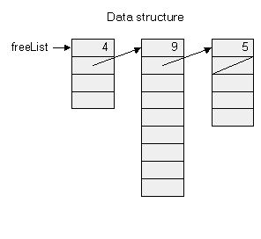
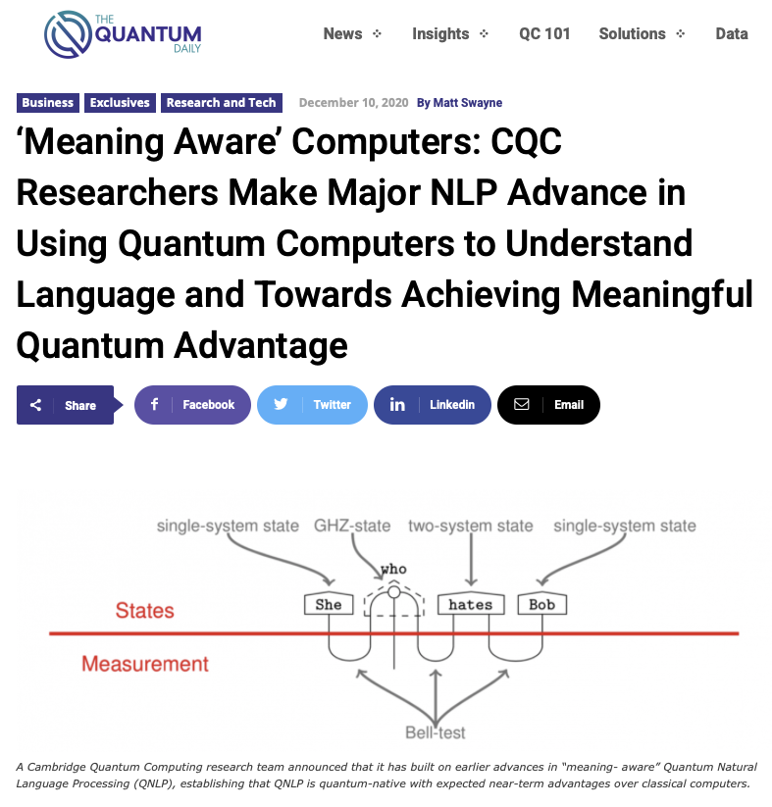
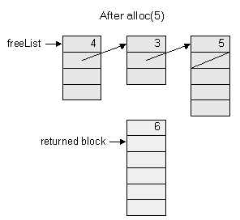

All computable content can be organized into a single Tapestry
Memory management in Jack Operating System

Slide 3
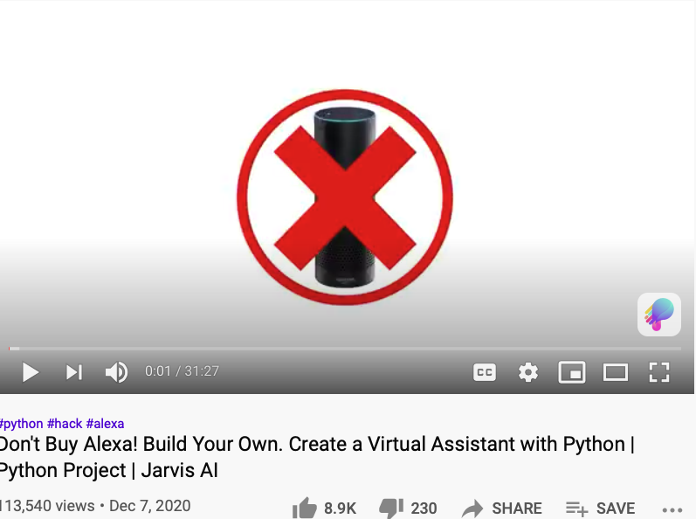
Some Natural Language Processing Tutorials

Slide 4
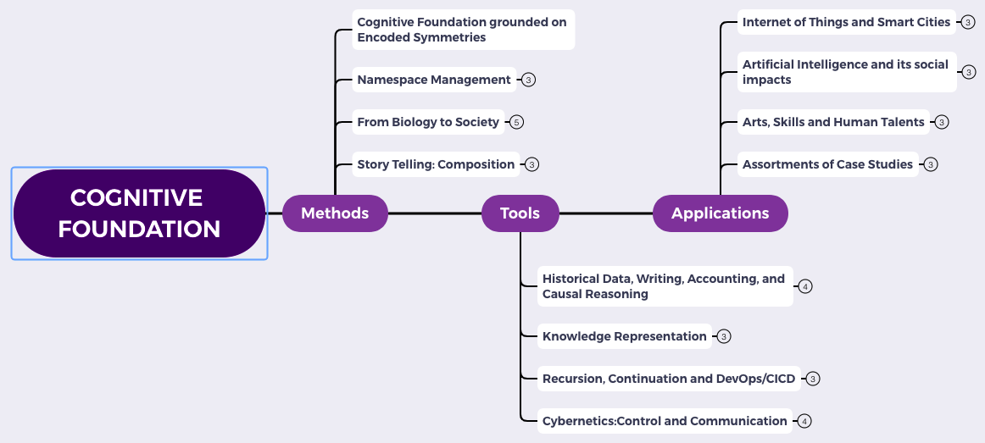
Content Themes for the semester
Overview
Namespace Management
Biology, Physics, Math, Code is Law, and Society
Story Telling, Functions/Metaphors/Analogies
Writing, Accounting, Historical Data and Temporal Reasoning
Knowledge Representation in Wiki and Files
Recursion and Continuation (DevOps/CICD)
Midterm Reports by Students
Cybernetics (Control and Communication)
Smart City and Internet of Things
Artificial Intelligence and its Social Impacts
Arts/Skills/Human Talents in the Digital Era
Student proposed Application Topics
Rehearsal
Final Reports and Celebration

Slide 5
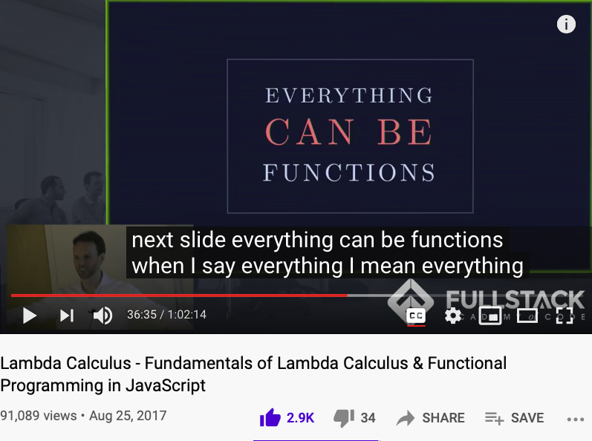
Universality is in your pocket (cellphone)
A lecture that students of Cognitive Foundation must watch several times…

Slide 6
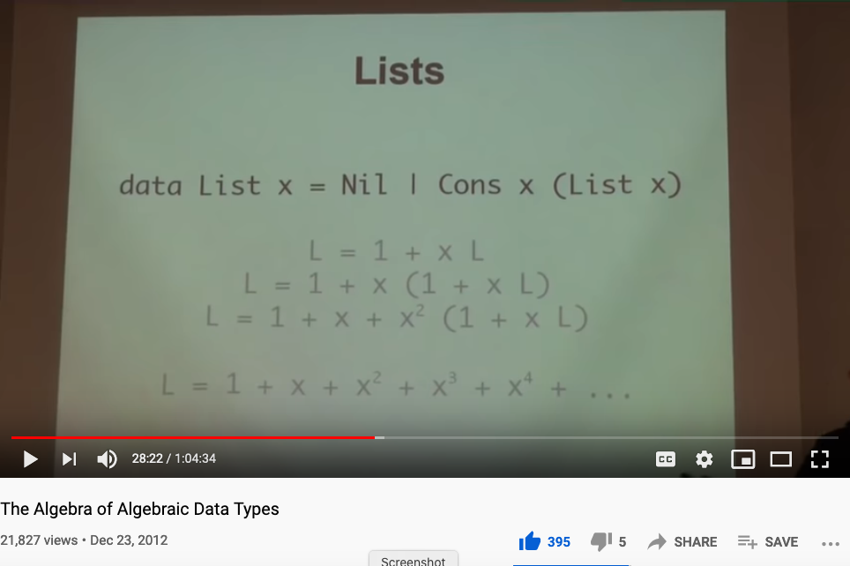
Did you watch the video on Types?
Huawei VP Mr. Yang Shaoqing
The Algebra of Algebraic Data Types

Slide 7

Logic Model
Logic Model
Output: A taste of your final paper
Process: Talking amongst yourselves to known about your latest progresses.
Input:
The previous lectures.
Supplementary materials
Your own efforts to research
Context: Preparing you to make final presentations.
Goal: Remind you that Cognitive Foundations should be compact and focused.
Criteria:
Focused: Good stories have one main trunk.
(All thesis must have only one main topic.)
Coherent: How branches are connected to the main .
(All content must be coherently connected.)
A well-defined set of Actions and iterative Branching Strategies
A Roadmap of composable activities
Sequencing and timing conditions
Explicitly state dependencies and resource requirements
Boundary Conditions: audience must be willing to make an effort to finish your assignments.

Slide 8
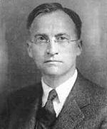
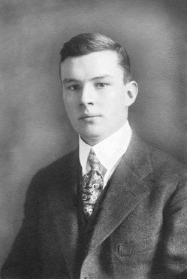
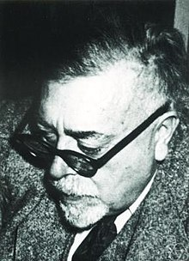
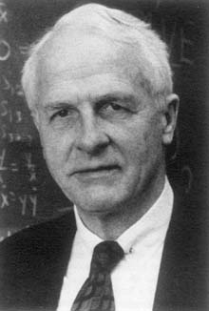
The Members of a Bird Watching Club
advisor
to
Members of
the same bird watching club
George D. Birkhoff
father of
Haskell Brooks Curry
Norbert Wiener
During this period, Curry had become interested in logic. Originally, all of his logic was reading on the side, and at one point he was supposed to be working on a dissertation on a topic in differential equations assigned to him by George D. Birkhoff. Furthermore, he was getting advice from various faculty members at Harvard and elsewhere to stay away from logic. This advice was especially strong from Norbert Wiener, who was at MIT and who was a member of the same birdwatching club as Curry. But Curry had become too interested in logic to stop thinking about it.
- excepts from Internet Encyclopedia of Philosophy
Garrett Birkhoff
(Lattice Theory)

Slide 9





Bird Watcher and Combinatorics
I, K, B, C(W), S
Idiot
Blue Bird
Kestrel
Cardinal
Startling
The website of absint.com stated: “Safety standards like ISO 26262, DO-178B, DO-178C, IEC-61508, and EN-50128 require identifying functional and non-functional hazards and demonstrating that the soft­ware does not violate the rele­vant safety goals.”

Slide 10
Be Persistent…
Tries to convince each other
Haskell Brooks Curry
Norbert Wiener
Curry had the idea for using operators which he called combinators, the term we still use today. He used these operators to analyze this rule of substitution, and he concluded that this idea might lead to a dissertation. When he took this idea to several professors, he got a different reaction than he had previously had about staying away from logic. This was especially true of Norbert Wiener at MIT, who said that his opinion had been that logic was a subject to be avoided “unless you had something to say,” and since Curry clearly had something to say, “strength to your right arm!”
- excepts from Internet Encyclopedia of Philosophy

Slide 11
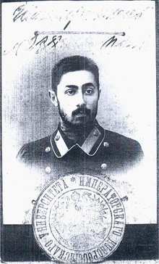
An Inherited Idea: Function Currying
Acknowledged the source from
Haskell Brooks Curry
Moses Schönfinkel
The method of using only functions of one argument has come to be called currying, … Curry himself learned of this use of his name in his last years, and he protested because he had gotten the idea from Schönfinkel, but this use of Curry’s name has stuck.
- excepts from Internet Encyclopedia of Philosophy

Slide 12
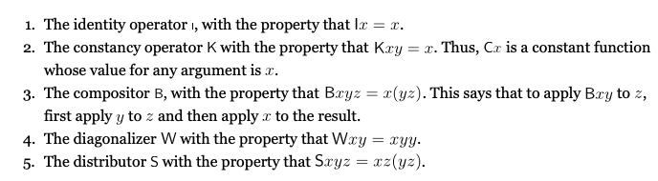
The Five Combinators
I, K, B, W, S
I
K
B
W
S
- excepts from Internet Encyclopedia of Philosophy

Slide 13
An issue in Name Space Management
Over his career, Curry changed several times the words he used to denote the formal objects of a formal system. In his earliest work on combinatory logic, he called them “entities” (using the German word Etwas as a noun in his dissertation, which was written in German). However, in a discussion with a philosopher (whom he did not name in his later years), he was told that his use of that word implied some philosophical conclusions with which he disagreed. At that point, he decided to use the word “term” instead. It is now common to refer to “combinatory terms” and “𝝺-terms”. However, this caused him a problem when he was dealing with a formal system of logic with quantifiers, since the terms would be what are usually called “formulas”, and there are other formal objects called “terms”. So in the end, he coined his own word by taking the first syllable of the word “object”, and started calling them obs. To some people, the word ob appeared to refer specifically to combinatory logic, but in fact Curry used the word for formal objects of any kind of formal system.
- excepts from Internet Encyclopedia of Philosophy

Slide 14
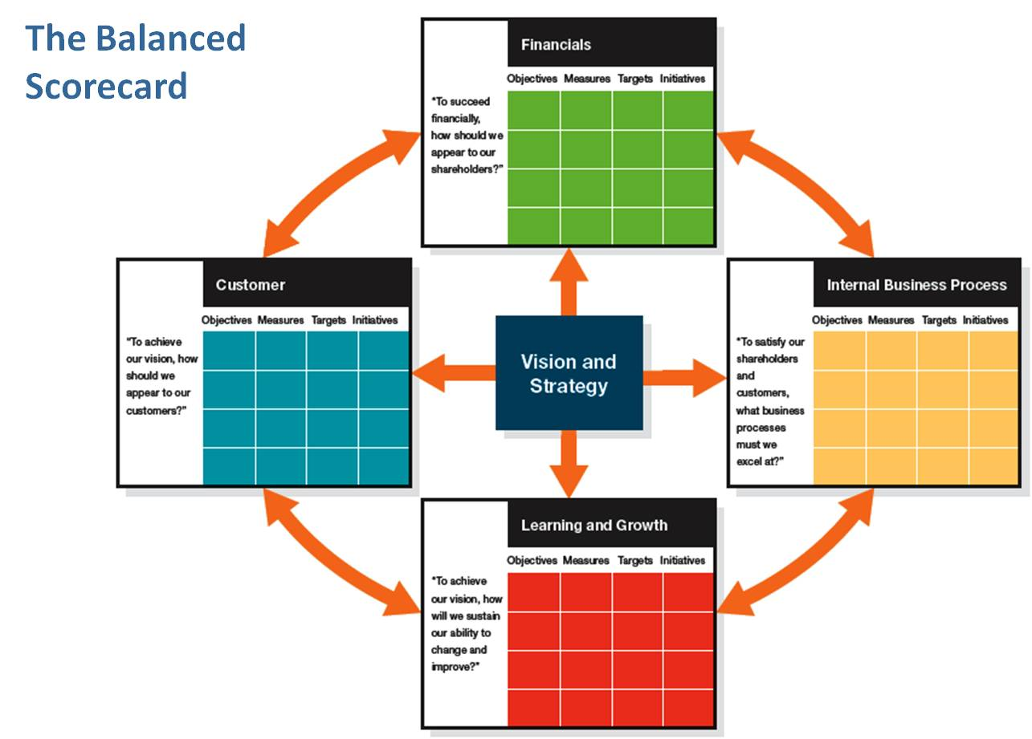
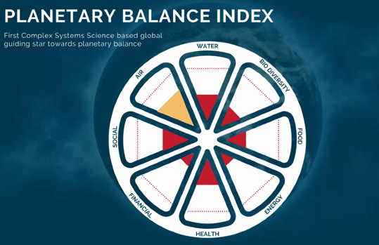
Color code and rearrange the “Balanced Index”
Energy
(Initial Object)
Financial
Food
Air
Health
Water
Internal Social
External Social
Bio Diversity
(Terminal Object)
Learning and Growth

Slide 15
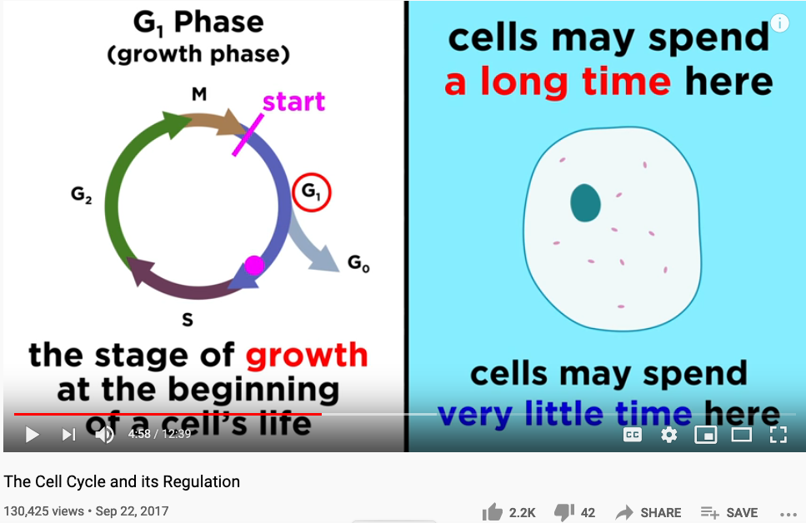
Color code and rearrange the “Balanced Index”
Professor Dave Explains: The Cell Cycle and its Regulation

Slide 16
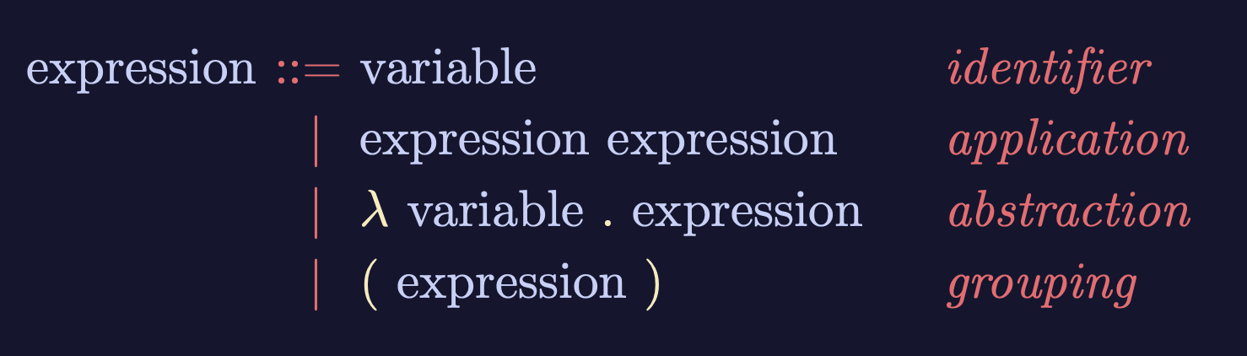
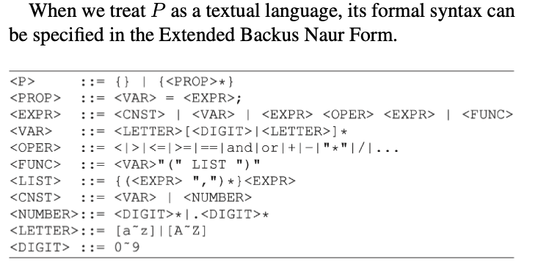

Lambda-Calculus is an Ouroboros
Variable
Expression1
Expression2
𝜆
Variable
Expression
( )
Expression
Lambda calculus as an executable rewrite process is a Lattice/Poset.
Paradigm shifting concepts
and
incommensurable terms
Normal Science
Model
Drift
Model Crisis
Model Revolution
Paradigm
Change
Learning as a vocabulary acquisition process!
Backus-Naur Form provides a way to customize the “concrete syntax” of formal languages.

Slide 17
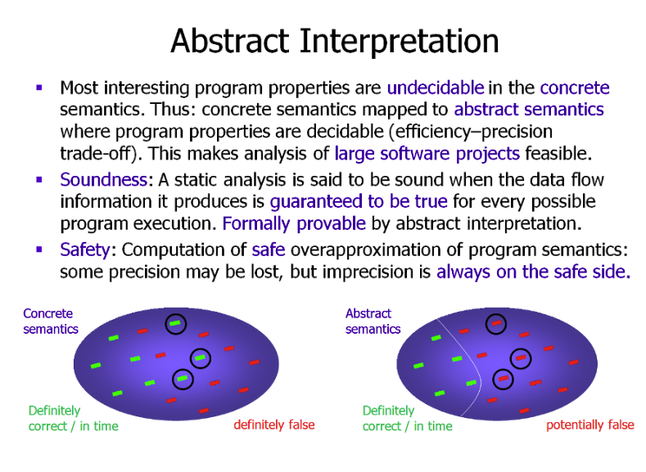
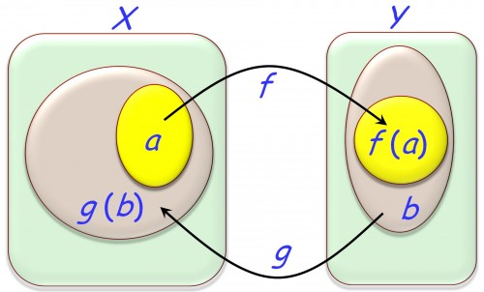
The Abstract and Concrete Domains
You may think of different colors represent different “intervals”. Where intervals are representable as bounded regions mathematically modeled as Lattices or Posets..

Slide 18
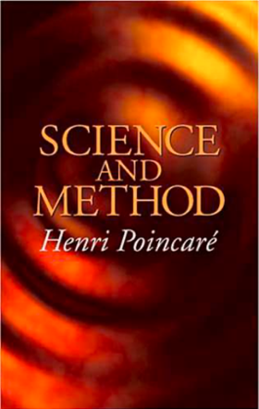

What is a sound methd?
A natural equivalence that is
up-to-isomorphism to relevant domains.
A method that matches your application context,
without the losing scope of possible alternatives.

Slide 19
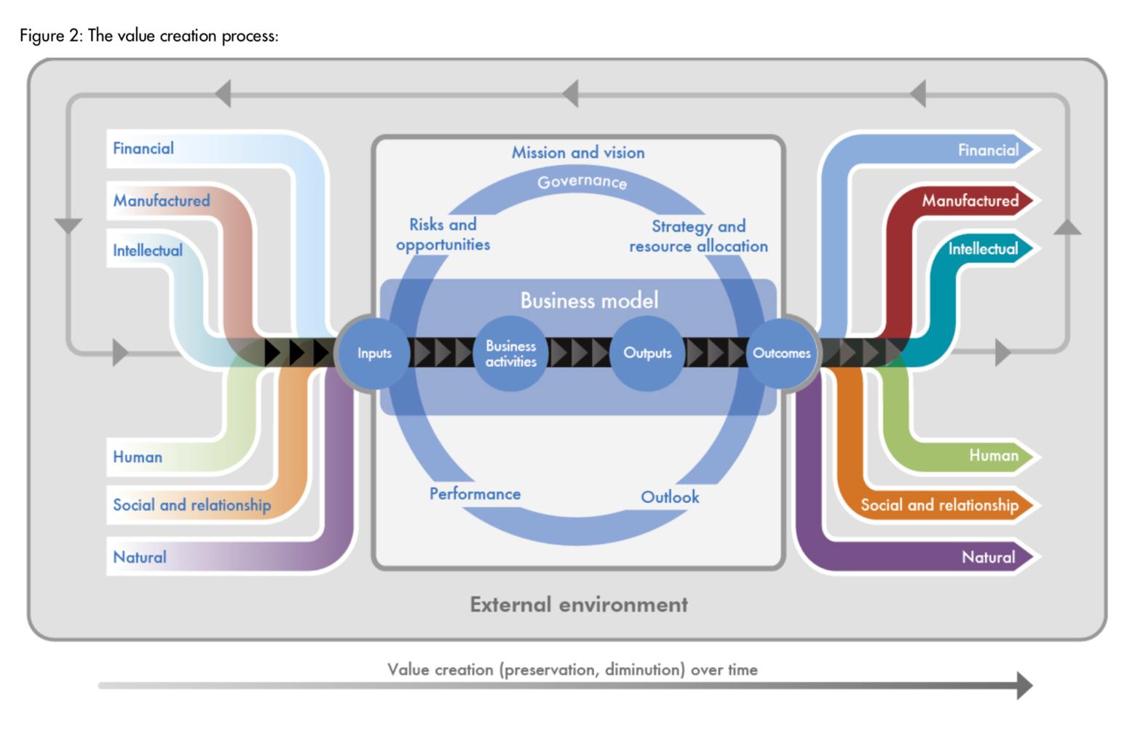

Accountants’ Ouroboros
The International
Integrated Reporting
Framework
Dec. 2013
Notes:
“historian James Aho linked double-entry bookkeeping to the ancient art of rhetoric,”
Excerpt From: Jane Gleeson-White. “Double Entry.” Apple Books.

Slide 20
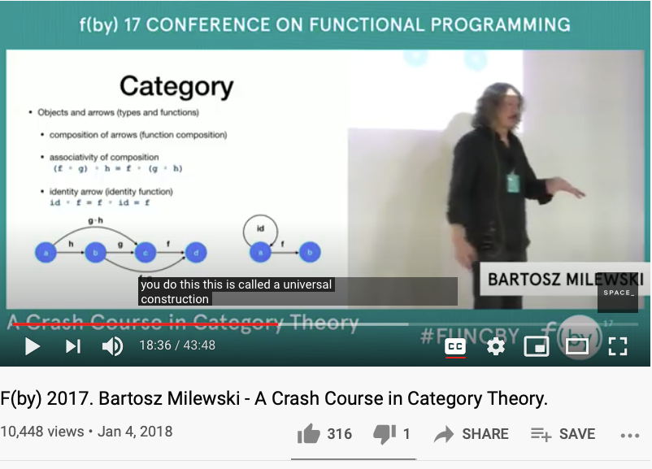
A Quick Review of Universal Objects in Category Theory
https://youtu.be/iJ7V1KXJpsE?t=1116

Slide 21

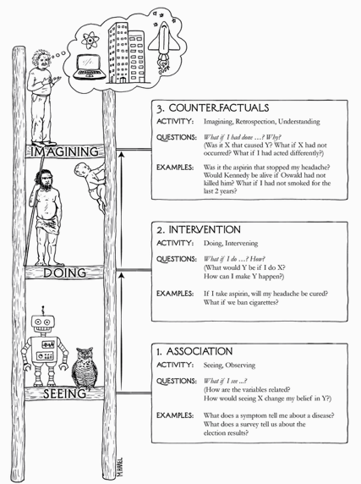
The Three Stages of the Cognitive Ladder
Why/Counterfactuals
Learning comes from What if assumptions…
How/Intervention
perform action under “Free” will
What/Association
the common observables

Slide 22
How big is the size of What If possibilities?
How/Intervention (a methodical way to intervene complexity)
Most of the operational what-if possibility spaces are rather small, so that people can deal with them with their “natural” talents…
Big Data (Software Industry) and AI brings complexity to an operational level, small code changes could result in major consequences in software controlled systems, which is almost everything we deal with on daily basis …
How to keep Abstraction separated from Concretization?
The Cognitive Discipline wrapped around in: Namespace Management (NsM).
What if complexity becomes overwhelming? Recursively apply NsM!

Slide 23
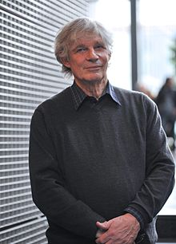
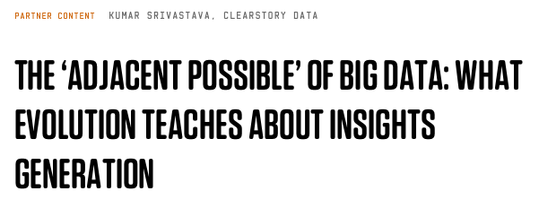
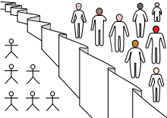
What foundation is universally trust-worthy?
What/Association (a unitary foundation)
Is there a generic data type/algebraic structure that is applicable to all?
Poset/Lattice/Monad (the foundational abstract data type) has concrete specification, and can be stored, and manipulated using scalable computing devices …
The ”Associations” in Partially Ordered Set: Adjacent Possibilities (Stuart Kauffman)
Wikipedia: Veil of Ignorance

Slide 24
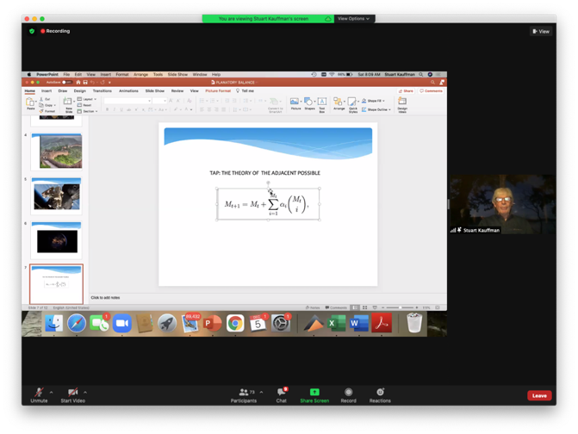
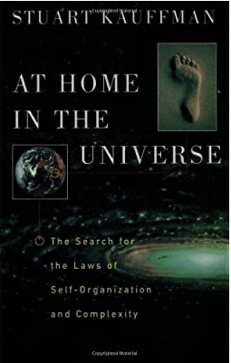
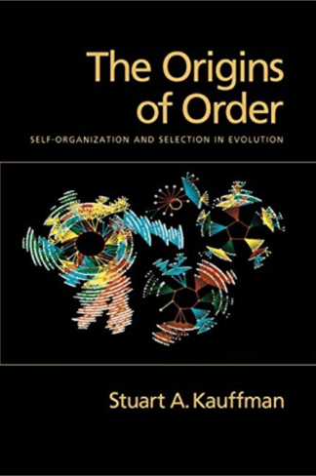

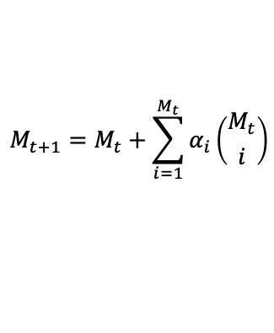
A Unifying Formula by Stuart Kauffman
The Theory of the Adjacent Possible
$$M_{t+1}=M_{t}+\sum_{i=1}^{M_{t}}{α_{i}\left({M_{t} \atop i}\right)}$$
Complexity Coherence Conference 2020
Stuartt Kauffman is an American medical doctor, theoretical biologist, and complex systemsresearcher who studies the origin of life on Earth. - wikipedia

Slide 25
What is the idea of Nature?
The Chinese phrase for Nature is: 自然！
Huawei VP Mr. Yang Shaoqing
The notion of “self” is related to the notion of
Identity morphism in Category Theory
Where the highest order of morphisms is called:
Natural Transformation

Slide 26
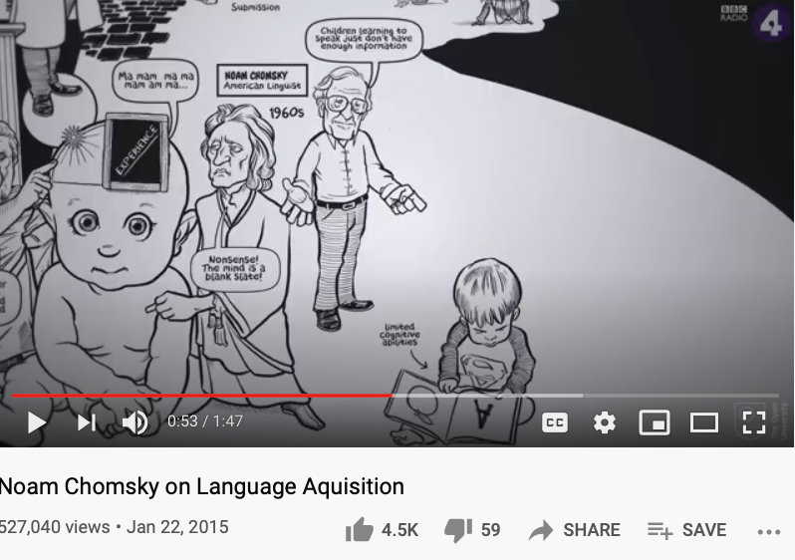
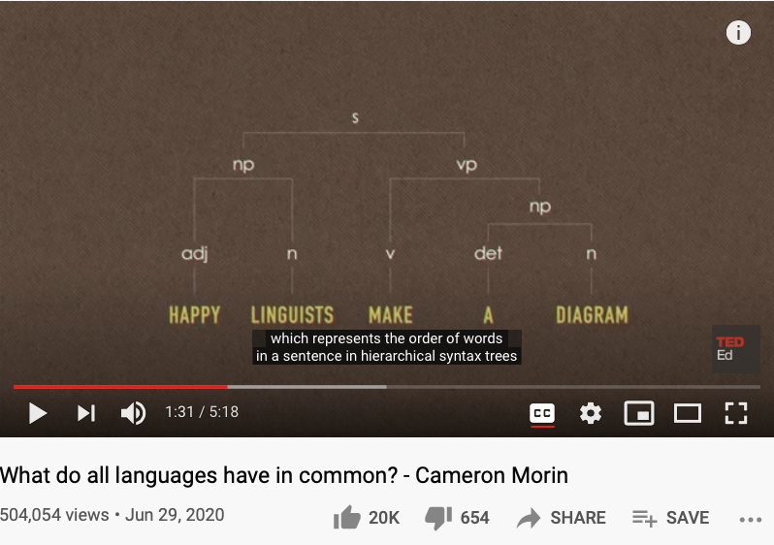
What is a “Self” ?
Is there a finite set of actions to verify the existence of self?
Is there a “universal grammar” that is applicable to all?
https://www.openculture.com/2019/02/a-brief-animated-introduction-to-noam-chomskys-linguistic-theory-narrated-by-the-x-files-gillian-anderson.html

Slide 27
We live in a Smart World,
Driven by Physically Meaningful Data
Image credits: http://verses.io

Slide 28
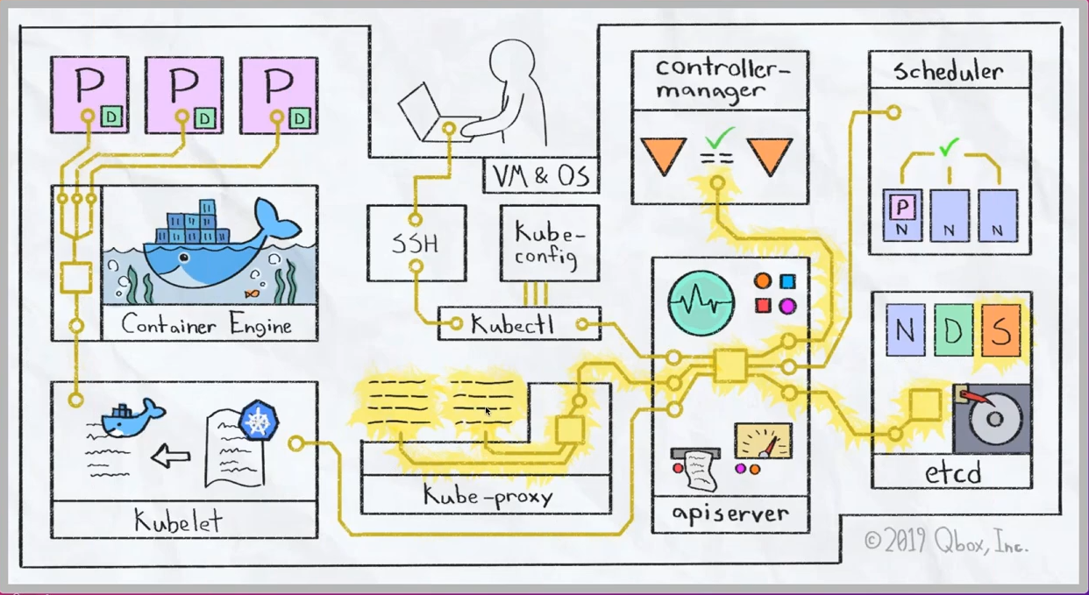
Operationalizing the Cybernetics
How to deploy a Kubernetes Cluster from Scratch (Youtube Link)

Slide 29
What, How and Why of “operationalization”
What/Association the common observables
How/Intervention perform action under “Free” will
Why/Counterfactuals the revealing “truth” or “surprises” related to relevant spacetime contexts
When all the data are driven by one consistent (foundational) framework
A new kind (previously incommensurable) model of belief system will emerge

Slide 30
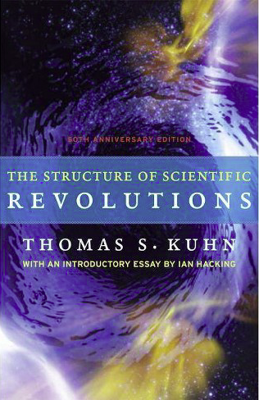

Kuhn Cycle: the evolution of a Namespace
Normal Science
Model
Drift
Model Crisis
Model Revolution
Paradigm
Change
Emerging cases or
systematic attacks
Product Development Process
in five stages
Commit
Build
Test
Stage
Deploy
Unknown/incompatible names introduces crisis. (incommensurability).

Slide 31


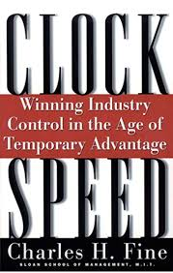




A Multi-Scale Collective Cognitive Processes
(students/teachers)
(Smart) Social Contract Execution
Traders
Miners
Coders
(Consumers/Distributors)
Three Asynchronous
Clocks in their respective
Communities
Version Upgrade
Production Code
Function Requests
Customer Crisis
Feature Revolution
Emerging cases or
systematic attacks
(Artists/Creative Projects)
(Administrators/Witnesses)
Perform Checking
receive confirmation
commit transaction
(Content Producers/Product Designers)
(Accountants/Lawyers)

Slide 32
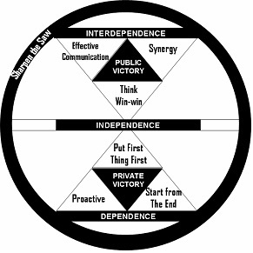

Some Emblems (Mandala)
Public Domain Data
Smart Contract Data
Private
Data
Notes:
1. 對稱性是底層的不變性
2. 在Cyberspace上，數據、操作數據的方式、操作數據的基礎架構，是資產的根本
3. 邏輯模型是凝聚群體意識的有效框架
4. Devops 能夠高效實現不同規模的Logic Model, 藉由（不同層次）數據可視與可控

Slide 33
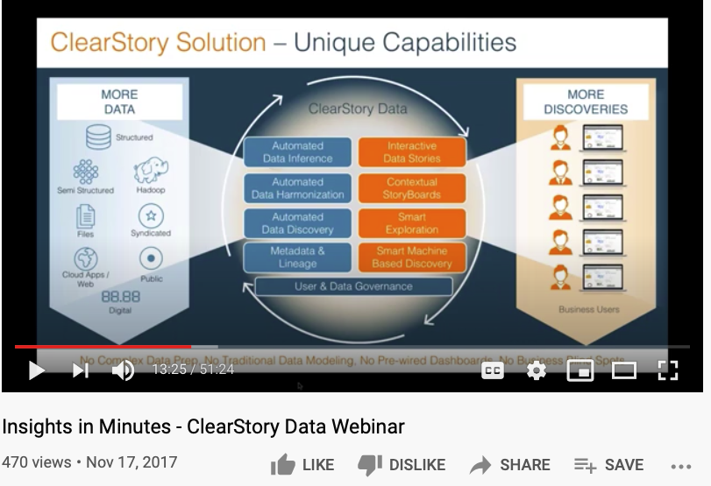
Try to get to the Primary Source through Data

Slide 34
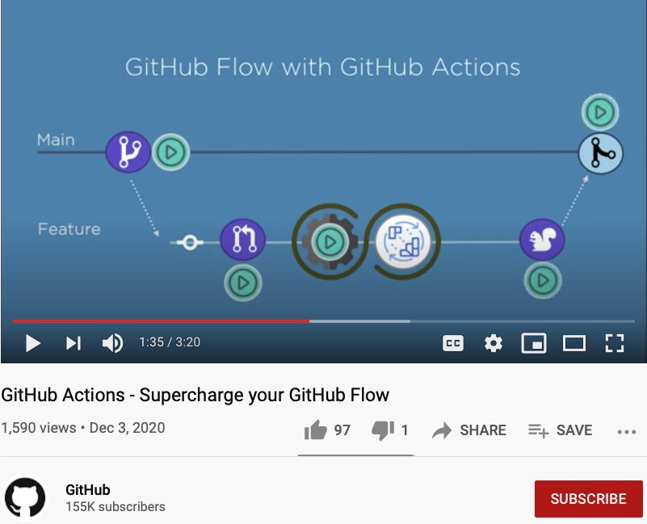
Data-driven Workflows are alive, globally! (Github Action)

Slide 35
Universality is in your pocket (cellphone)
A lecture that students of Cognitive Foundation must watch several times…

Slide 36
A curriculum based on Data-assimilation Orientation

Slide 37
Conclusion/Summary
The Trans-Disciplinary Cognitive Foundation is based on Logic:
Namespace management (NsM) and optimization can be supported by computers
The speed of NsM processing is dependent on both algorithmic efficiency and available resources
Cognitive foundation should be grounded on Primary Sources:
Why: Reduce errors introduced by intermediaries, and allow for self-sufficient error-detection/correction. A compact cognitive foundation enables more self-check.
How: Modern data-driven infrastructures are readily available
What: You need to tell an exciting story of your own, starting next week…

